Slide 1
Employment Rights Bill & Fair Pay Agreement: preparing for the changes ahead
The Managers Conference | National Care Forum & Skills for Care | 11 March 2025
Professor Vic Rayner OBE (CEO, National Care Forum)
Phil Orton (Deputy CEO, Making Space)
Nina Hemmings (Researcher, Nuffield Trust)

Slide 2
Key areas for change proposed in the Bill
End zero hours contracts
Strengthen statutory sick pay
Day 1 rights and flexible working
Fair Pay Agreement in social care

Slide 3
End ‘exploitative’ zero hours contracts
What’s the policy aiming to achieve?
End ‘exploitative’ zero hours contracts, addressing the problems of insecure pay and shifts for workers
Grant more security, through employers offering workers & agency workers ‘guaranteed hours’ contracts
Reasonable notice by the employer and agency of any cancelled or moved shifts, and renumeration by the agency
What might be needed to make it work?
Careful design – especially in homecare, and a workable timeframe for a ‘reasonable notice’ period
Back office support to administer, calculate and monitor hours
Funding for worker contracts
What does this look like in other countries?
Wales: homecare workers are offered permanent contracts after 3 months
New Zealand, Ireland, Norway: mandated guaranteed hours in contracts
Netherlands and Finland: workers who regularly work a set shift pattern, must be offered a contract on those terms
What is the government and sector still working through?
Balance between security for workers and flexibility for employers
Situations where there is a genuine need for temporary/ seasonal contracts
Notes:
Offering GH = more security for workers (who want it); avoids a perverse incentive to use agency staff in a sector where continuity of care for people using services is often vitally important
GH contract would be based on the hours regularly worked over a set period
Reasonable notice period – current regs set out “up to 7 days” – this would be very long in a SC context!
Govt’s consultation response does acknowledge the concerns of employers as to whether they would be able to offer temporary contracts where there was a genuine need and/or seasonal contracts. The Government has promised further consultation on that and regulations to specify the definition of temporary need.
Proposed amendment to the Bill - remuneration for cancelled or moved shifts – no more than the shift original amount
New Zealand provides funding to providers for cancelled shifts in certain instances such as where changes to shifts are unavoidable or arising from temporary circumstances.
Other countries have already taken steps to limit or ban zero-hours contracts in social care. New Zealand and Norway have banned these contracts outright and replaced them with minimum hours in worker contracts. Meanwhile, Ireland has prohibited them except for certain circumstances such as emergency cover. While Wales did introduce an offer of guaranteed hours for homecare workers into its regulations, some care sector representatives have suggested that this was not widely implemented because of funding constraints. Another approach taken internationally has been to still use zero-hours contracts but tighten up regulation and take steps to improve work security (for example, if workers regularly work a set shift pattern, they must be offered a contract on these terms), as is the case in Finland and the Netherlands.

Slide 4
Day 1 rights and flexible working
What’s the policy aiming to achieve?
Grant rights from day 1 of employment:
To parental leave and paternity leave
To bereavement leave
To not be unfairly dismissed
Improve access to flexible working by requiring employers to justify the refusal of these requests
What might be needed to make it work?
Understanding of how many workers might apply for flexible working
Ability of providers to recruit additional staff/ reorganise work among existing staff to meet service demand
How does this compare to other countries?
In Scotland, regulations require care providers to consider staff wellbeing in their rostering decisions
Germany has introduced childcare grants and additional days of annual leave
Notes:
The social care workforce is predominantly female (in England, representing 79% of the workforce) and many staff hold caring responsibilities.
Family leave – removing the qualifying period for paternity leave and ordinary parental leave (so employees have the right from the first day of employment), and expanding eligibility for bereavement leave.
Relationships covered by bereavement leave to be expanded, beyond parents who lose a child
Unfair dismissal – removing the two-year qualifying period (so employees are protected from unfair dismissal from the first day of employment), subject to a potential probationary period.
Flexible working: Care work is valued by many social care staff because it can allow flexibility around other commitments such as caring responsibilities.
Requesting flexible working from day 1 is already a statutory right; what the Bill does is requires employers to give the reason for refusing applications for flexible working (eg, burden of additional costs or inability to recruit additional staff)
As these are widespread major problems in the social care sector, we are concerned most social care employers could refuse employee applications on these grounds.
As a result, social care workers may opt to remain on zero-hours contracts for the flexibility it offers.
Worth noting some wider measures around protections against dismissal, for pregnant women and new mothers either on or returning from maternity leave
Germany – govt grants for childcare services tailored around specific working hours of care staff. Additional 7 days AL in 2022, 9 days in 2023 and 2024

Slide 5
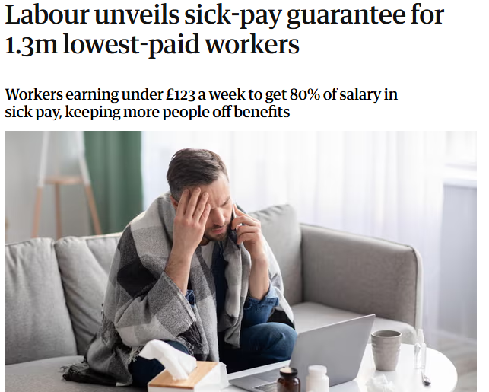
Strengthen statutory sick pay
What’s the policy aiming to achieve?
Widen access to statutory sick pay
Workers earning below the lower earnings limit (£123 per week) will be entitled to sick pay at 80% of their wages
Remove the 3 day wait period before getting sick pay
What might be needed to make it work?
Funding and support to provide cover for staff who are on sick leave from day 1
What is the government and sector still working through?
Timeframe for delivery – expected ‘next year’
How the Government can best support small employers with Statutory Sick Pay costs
How does this compare to other countries?
Norway offers sick pay at full wage for one year
Germany offers 6 weeks sick pay at full wage, followed by 1.5 years paid at 70% of gross salary
Notes:
More specifically: the weekly rate of statutory sick pay in Great Britain would be the lower of £118.75 (in April 2025) or 80% of an employee’s weekly earnings.
Government’s position on the 80% rate is: “strikes the right balance between providing the financial security that our lowest earners need, retaining the incentives to return to work when appropriate, and limiting the costs to businesses”
The govt did not consult on the actual rate of SSP for employees (ie £116.75/ 118.75) but noted many have called for increases to this, in line with NLW or as % of salary. The govt said employers could increase occupational sick pay.
Small employer = 250 employees or less

Slide 6
Fair Pay Agreement in social care
What’s the policy aiming to achieve?
Aims to setup a new Adult Social Care Negotiating Body, to negotiate and enforce minimum pay, training and T&Cs
Create equivalent negotiating bodies in Scotland and Wales
What might be needed to make it work?
Additional funding
Ways to monitor and ensure workers are paid the new minimum amount (government are setting up a new body - the Fair Work Agency)
What is the government and sector still working through?
Who will sit on the new body
Which workers will be in scope e.g. direct care roles, ancillary roles (cooks, cleaners), agency staff
In time, what other measures the new Body will look into (T&Cs, training etc)
What does this look like in other countries?
Scotland introduced the Real Living Wage in 2016
Wales introduced the Real Living Wage in 2022
New Zealand, Australia and France used collective bargaining to develop payscales for social care staff
Notes:
The Bill establishes the first legally binding mechanism to enforce and uphold minimum pay, terms and conditions and other policies – giving government the levers it needs to create a more competitive offer.
NB the bodies in Scotland and Wales could be setup to cover both adult and childrens SC.

Slide 7
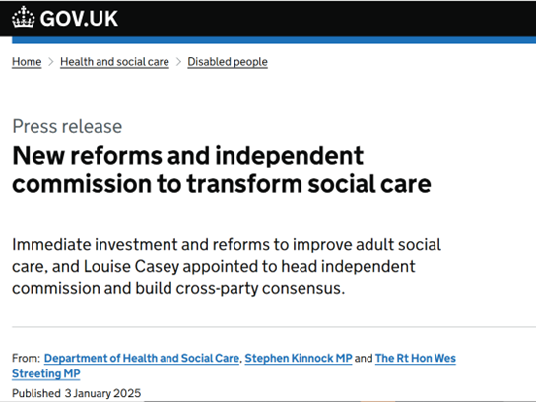
Also on the horizon…
Casey Commission:
Phase 1: reporting mid 2026 to “identify the critical issues facing adult social care and set out recommendations for effective reform and improvement in the medium term”
Phase 2: reporting mid 2028 to “make longer-term recommendations for the transformation of adult social care”
Comprehensive Spending Review:
‘Spring Forecast’ this month followed by multiyear spending review in June, to set budgetary envelope to ~2029

