Slide 1
Women in Tech
Claire Shuter
February 2023

Slide 2
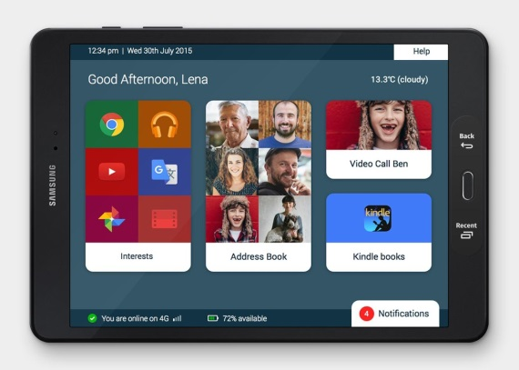
Defining moments - 1

Slide 3
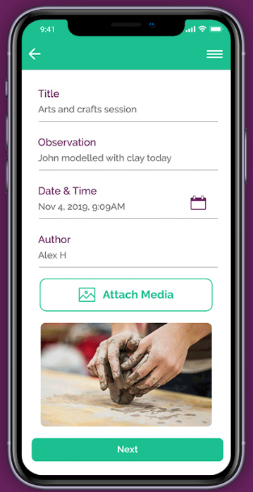
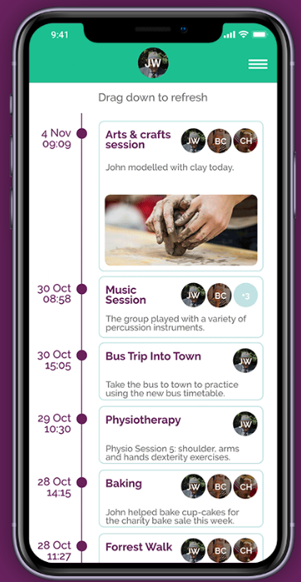
Defining moments - 2

Slide 4
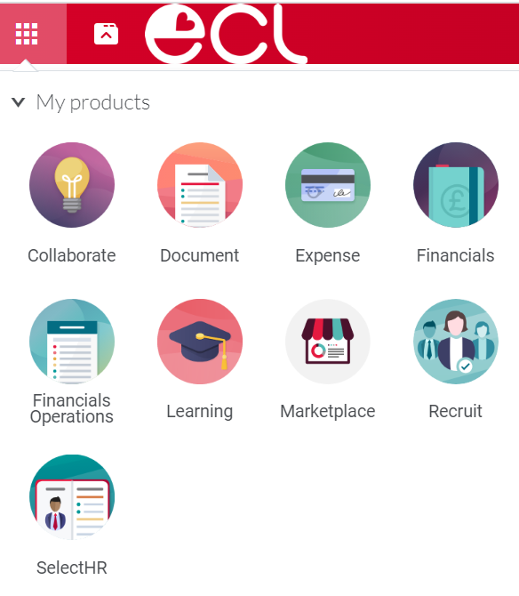
Defining moments - 3

Slide 5
To conclude

