Slide 1
GETTING STARS AND KEEPING THEM THE JOURNEY TO OUTSTANDING

Slide 2
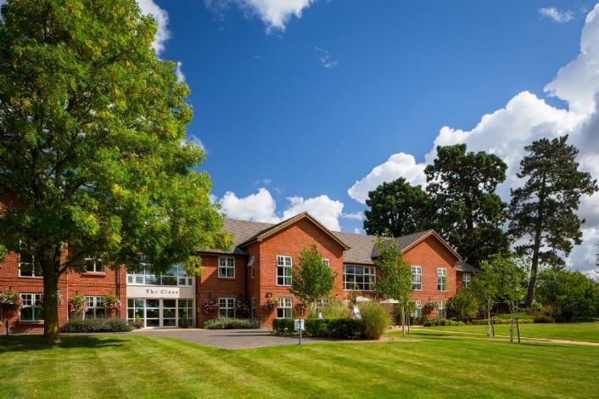
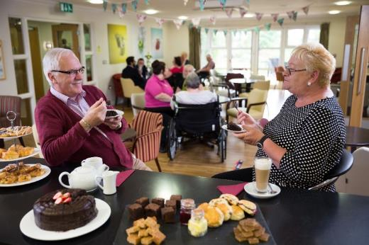
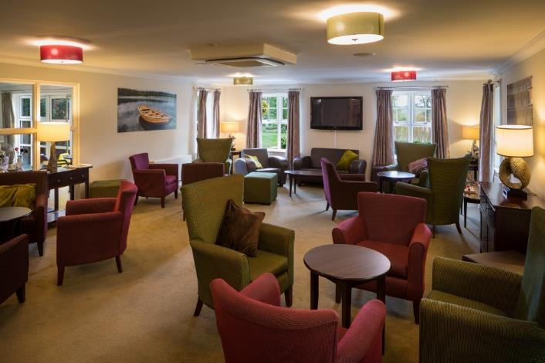
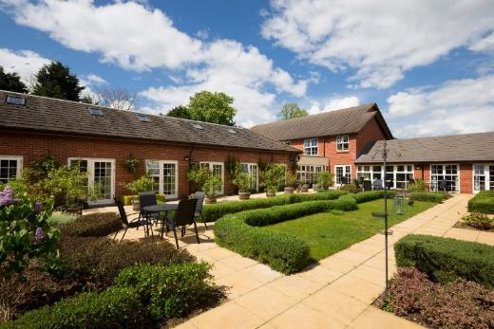
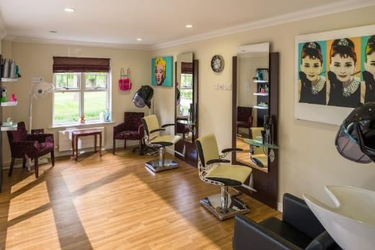
This is THE CLOSE
90 beds
South Oxfordshire location
4 acres of land
5 “suites”
35 beds dedicated to D&A
Bistro
Cinema
Full spec hair salon

Slide 3
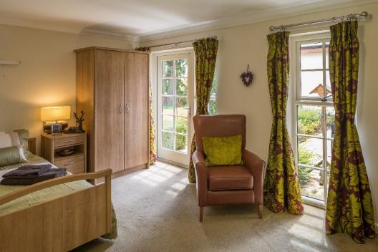
A little history…
2014

Slide 4
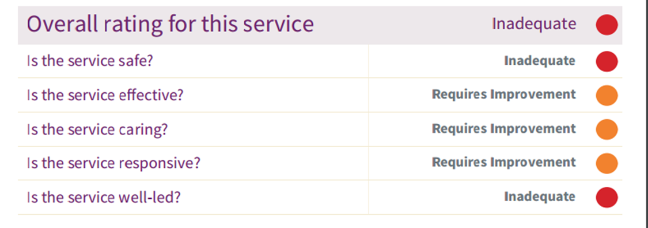
…OR SO WE THOUGHT…
2 warning notices
Countless regulation breaks
Local authority and CQC embargos
Occupancy down to 57 / 90
Staffing haemorrhage
25% own staff vs 75% agency
Whistleblowing central
Safeguarding's galore
Oh…. And to top it off an employment tribunal…. Yes really!!!

Slide 5
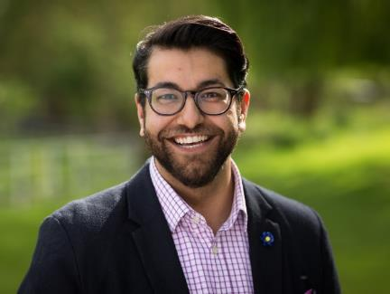
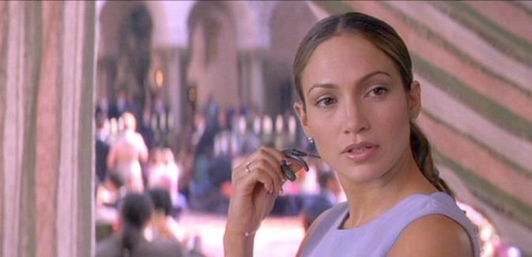
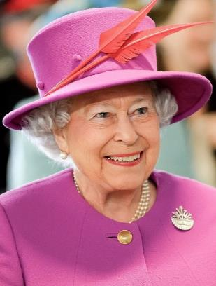
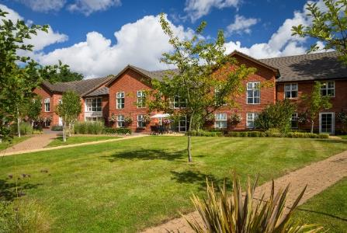
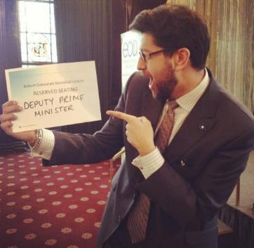
That’s were I came in…
Sanjay

Slide 6
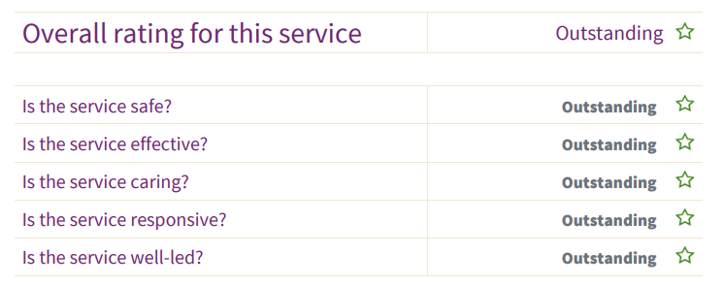
…how did we do?
Full GREEN OCC Report
Rolling contract with OUH
Winning Awards at National Comps
100% Occupancy
Staffing morale high
65% increase in own staff
ZERO Whistleblowing’s 60 months
93% reduction Safeguarding

Slide 7
…An Inspector calls
S.A.F.
PROVE ITs – Wins
From the managers office to the service floor
OUTSTANDING EVIDENCE

Slide 8
THE JUBILEE
WITH ANOTHER QUEEN!!!!!

Slide 9
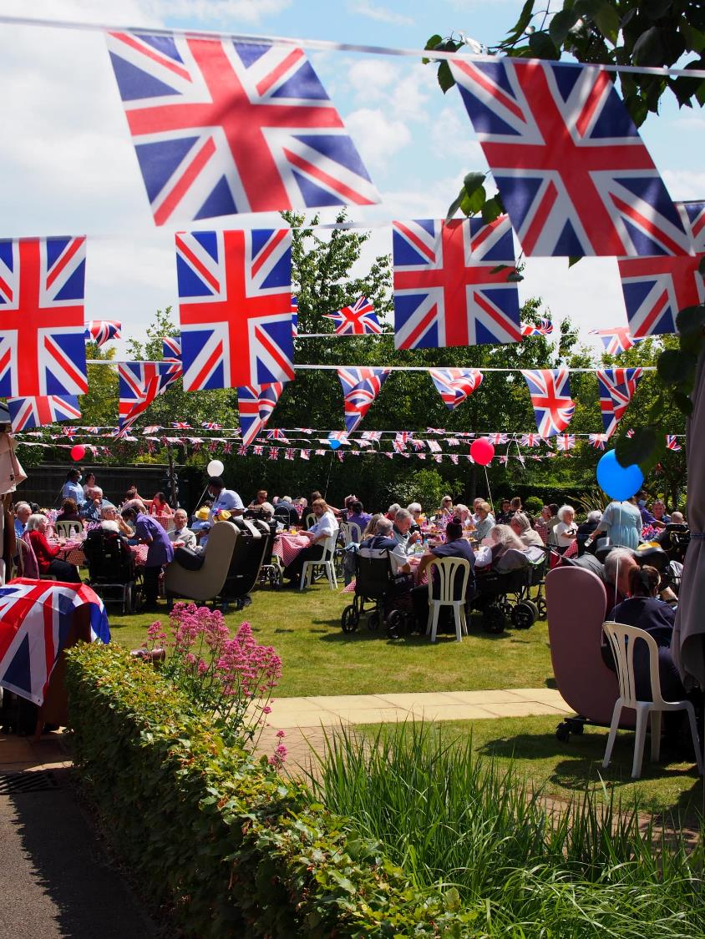

Slide 10
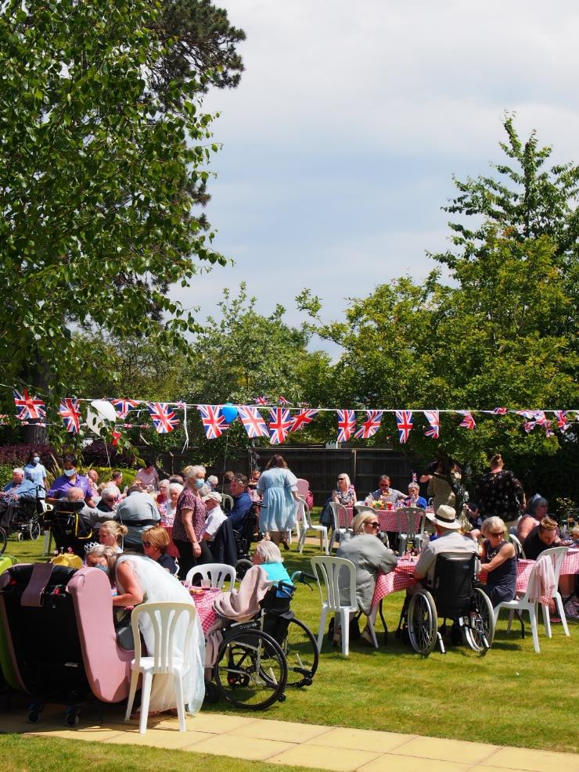

Slide 11
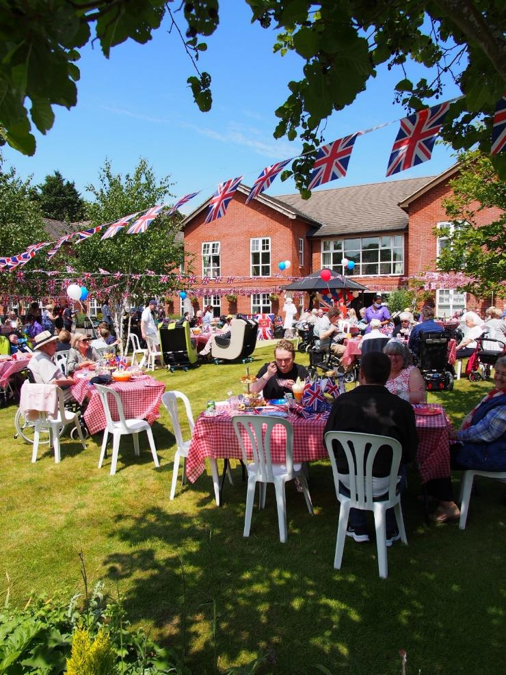

Slide 12
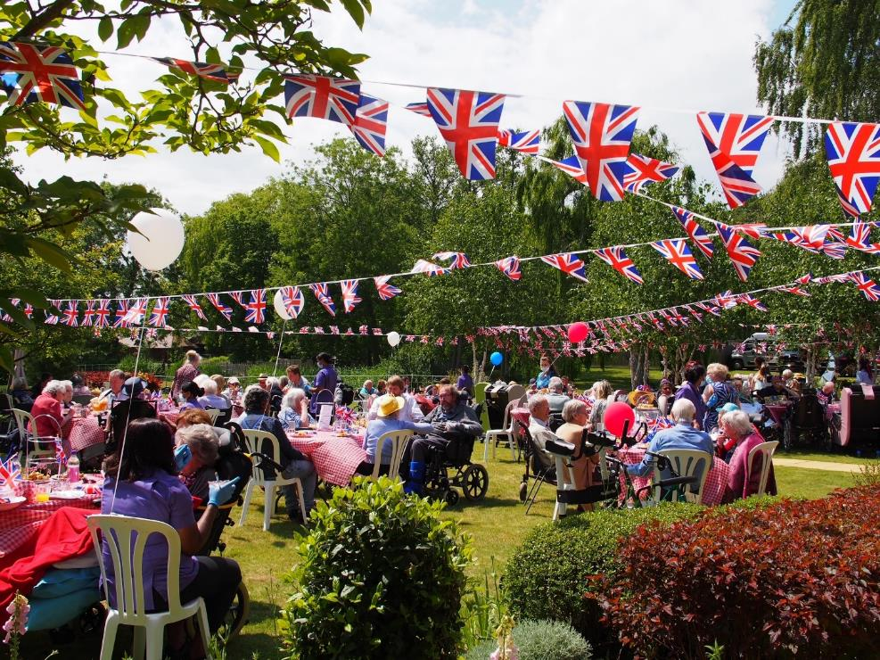

Slide 13
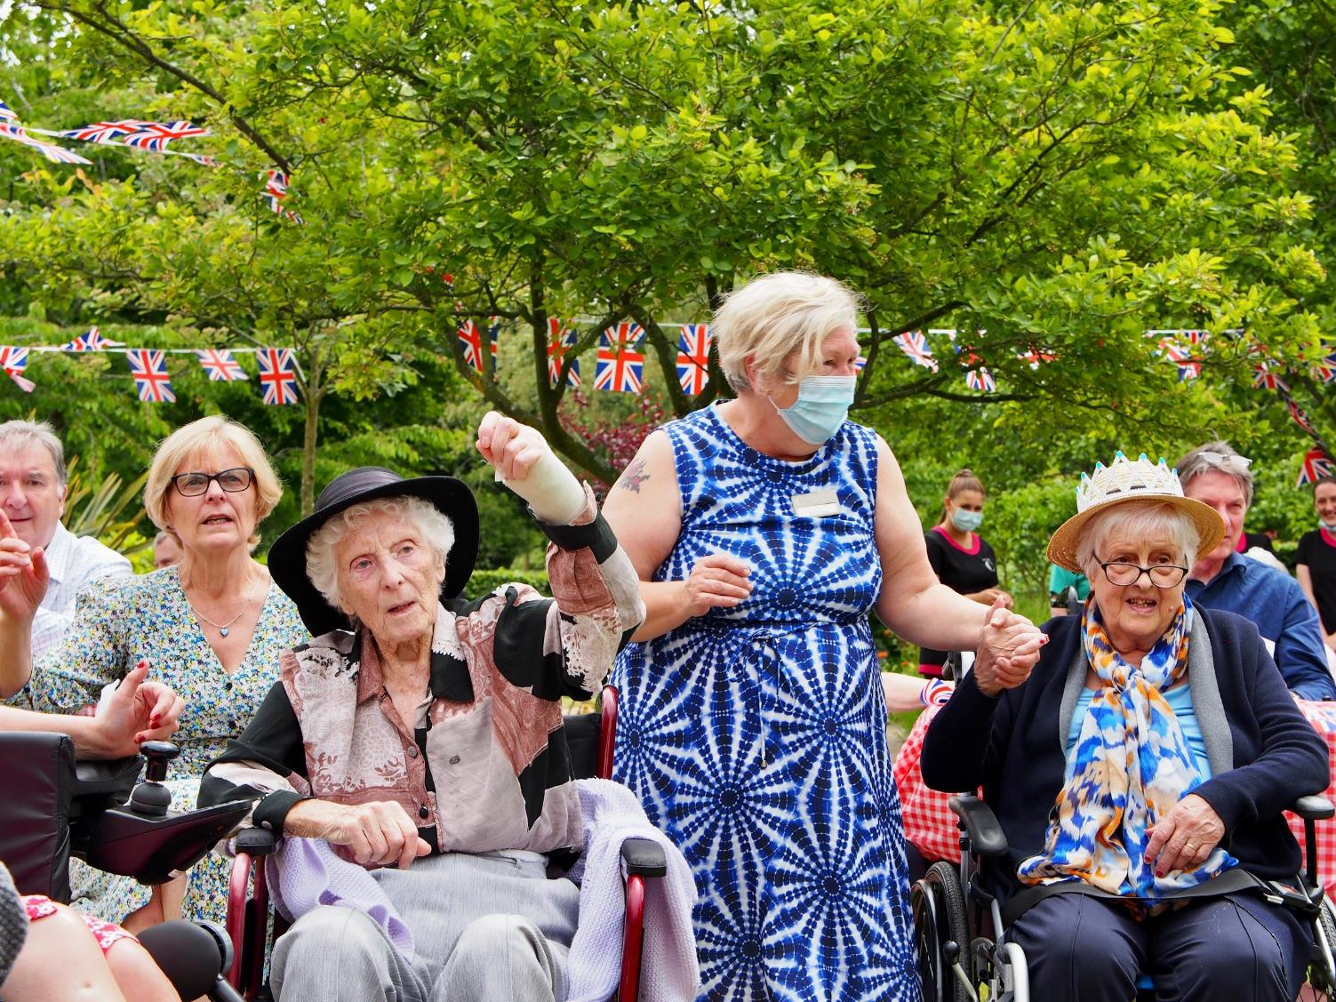

Slide 14
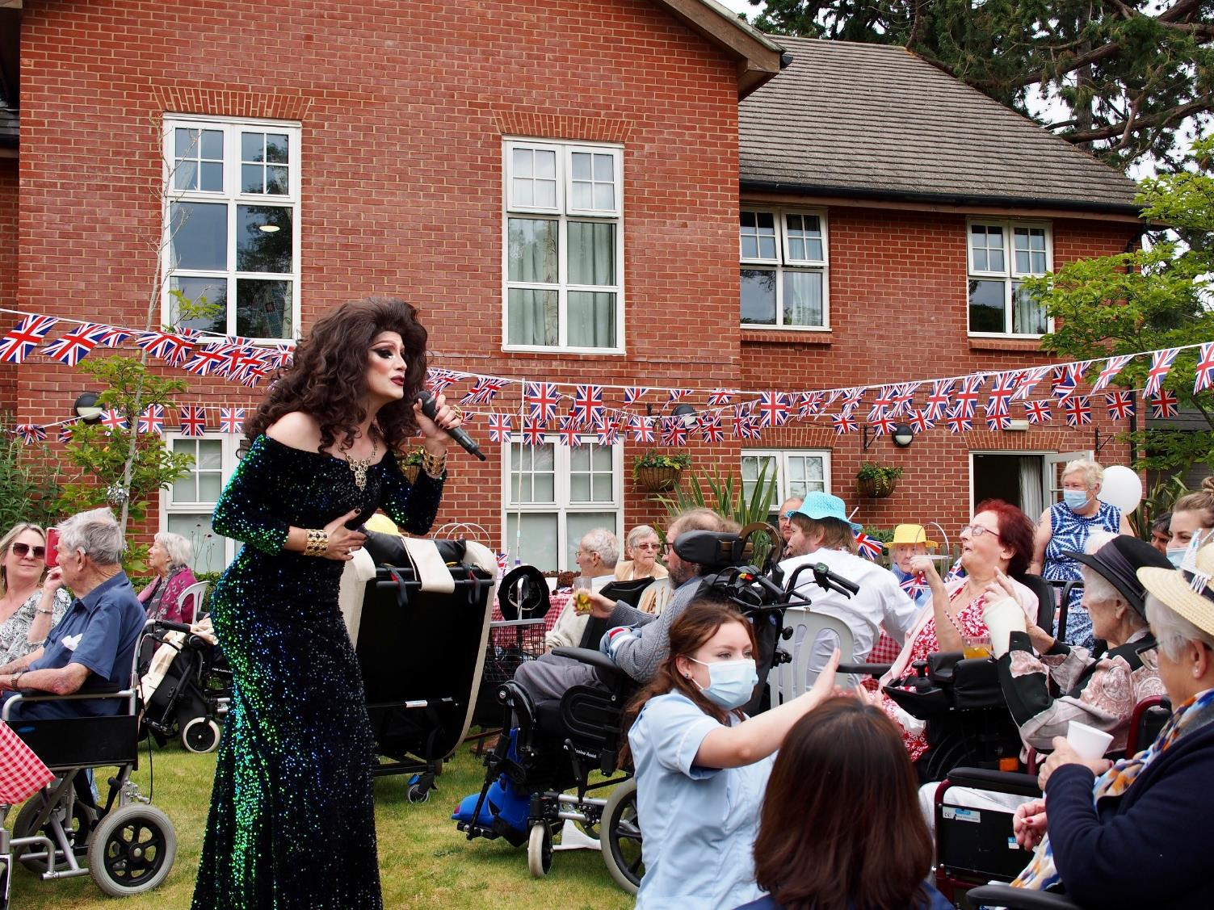

Slide 15
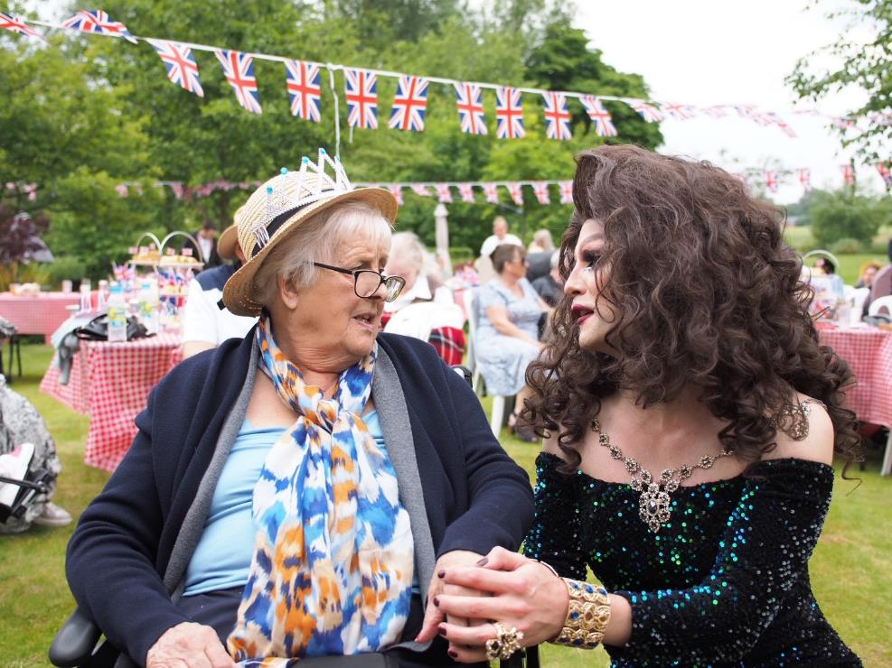

Slide 16
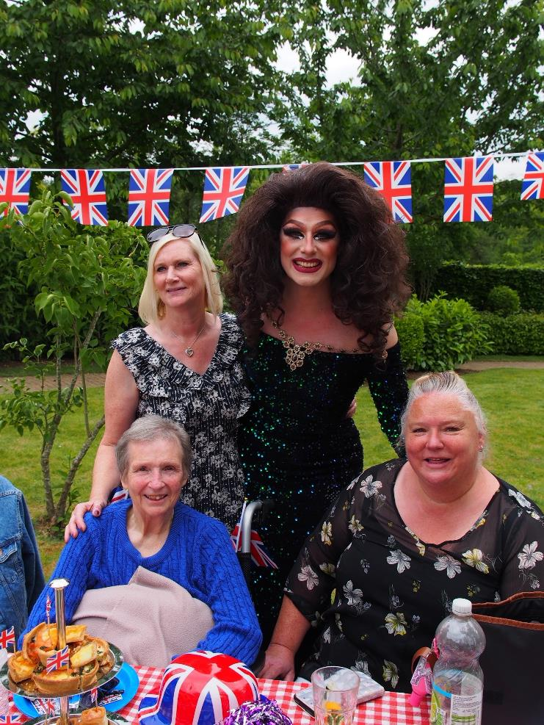

Slide 17
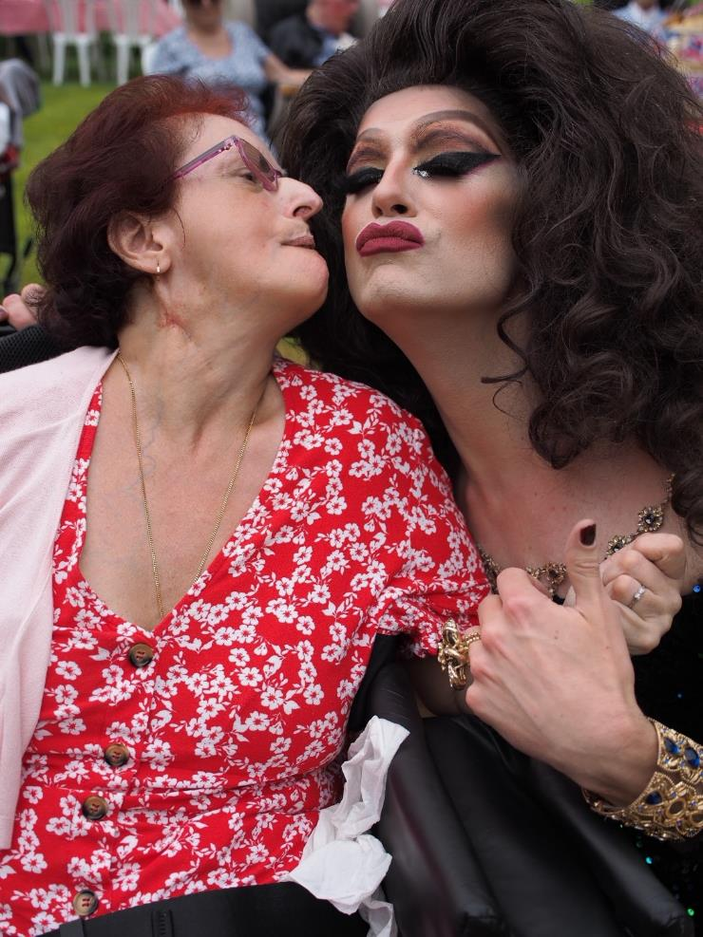

Slide 18
A NICE DAY FOR A….

Slide 20
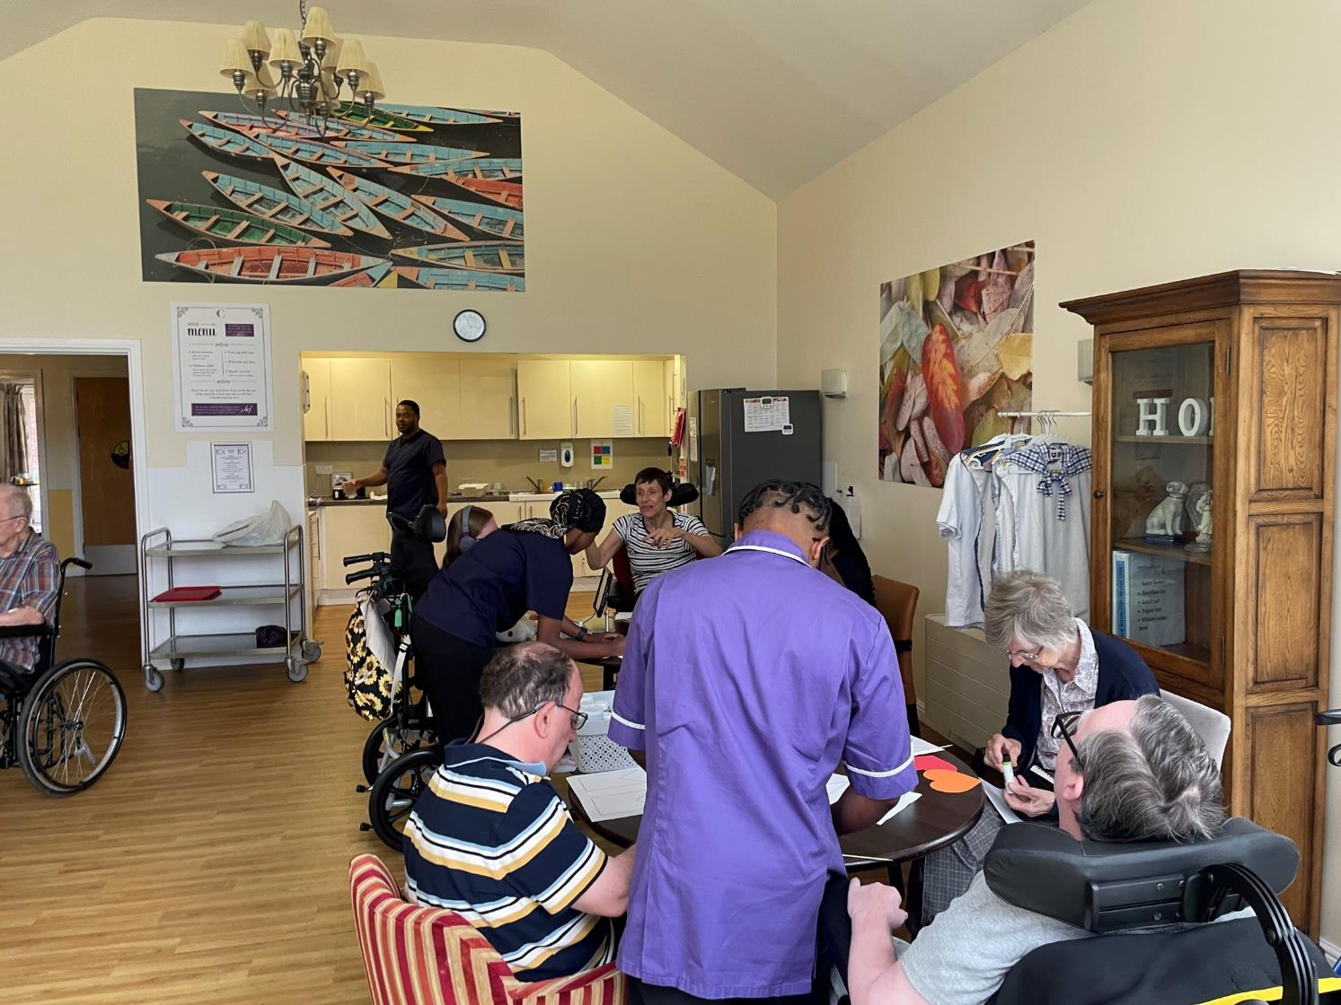

Slide 25
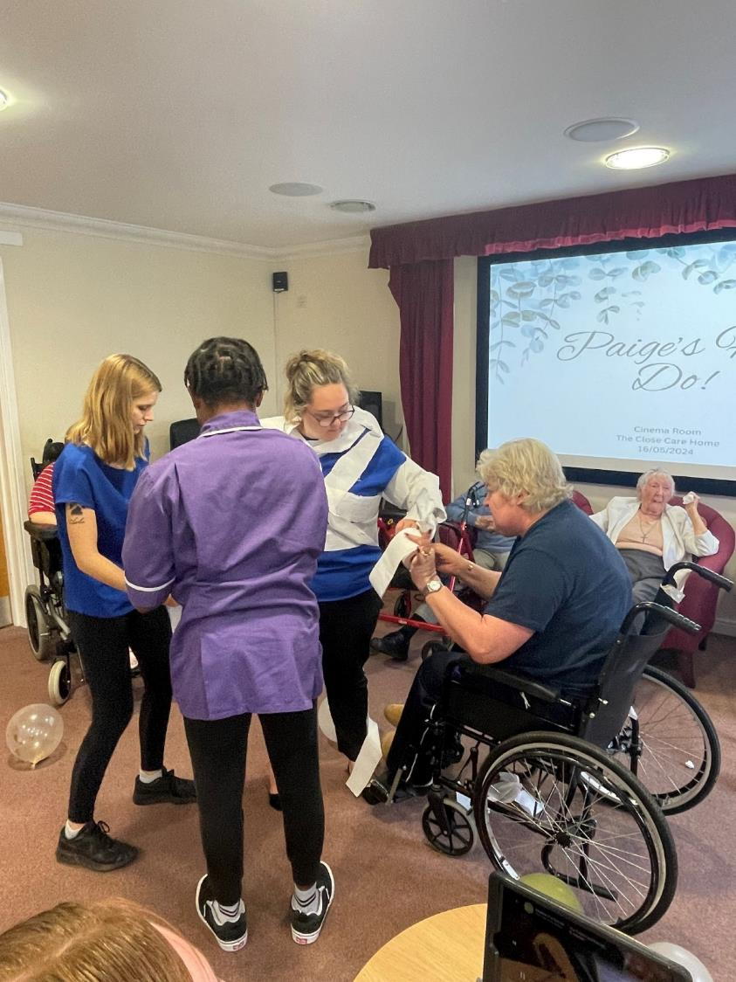

Slide 26
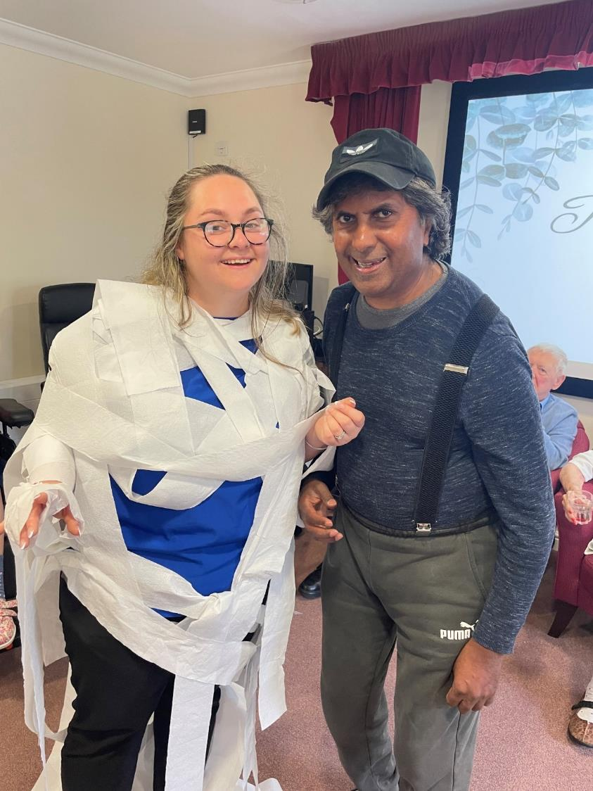

Slide 44
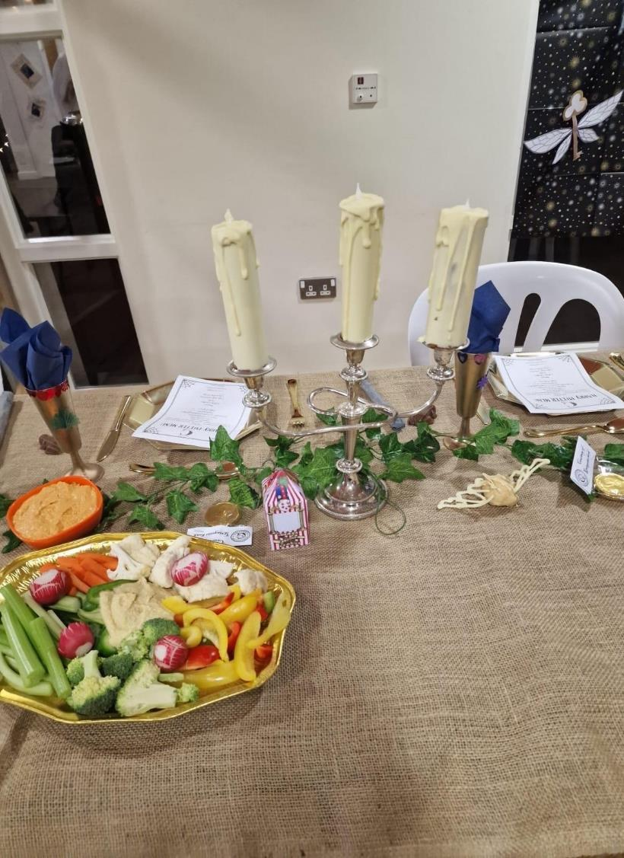
Those are Edible…. The Candles

Slide 55
Clothing Protectors

Slide 56
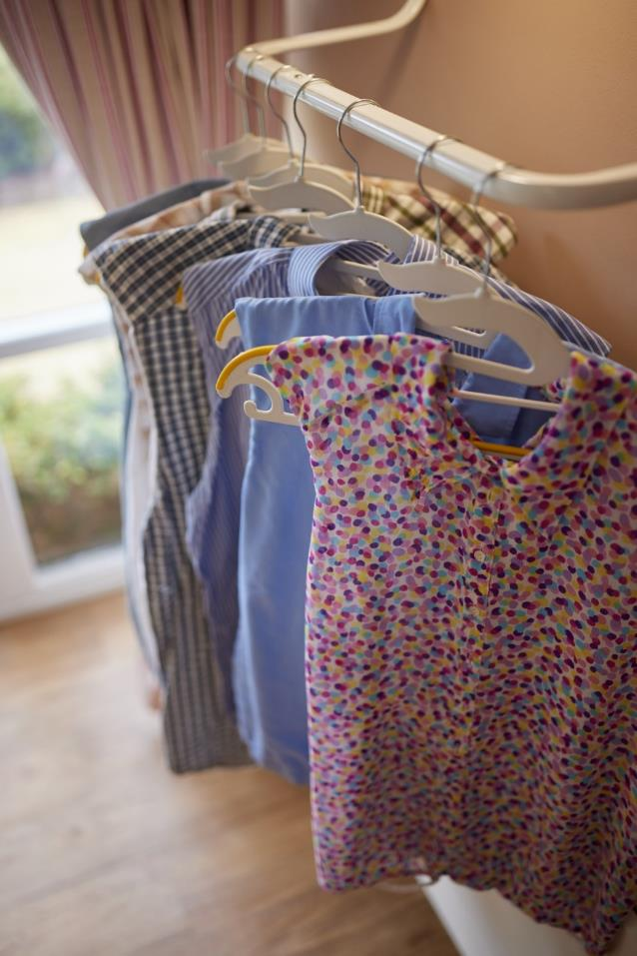
Our home made clothing protectors that promote equality and dignity at meal times as people are wearing “bibs” they are wearing proper clothing.
There are different versions for different times of the day. Pyjama style for mornings, casual for day time and more jazzy versions in the evening. For all genders. Residents choose the one they wish to wear for every meal hence the accessible presentation.
Free patterns and guide available on our website for people to download and re create as we really believe in sharing our ideas.

Slide 57
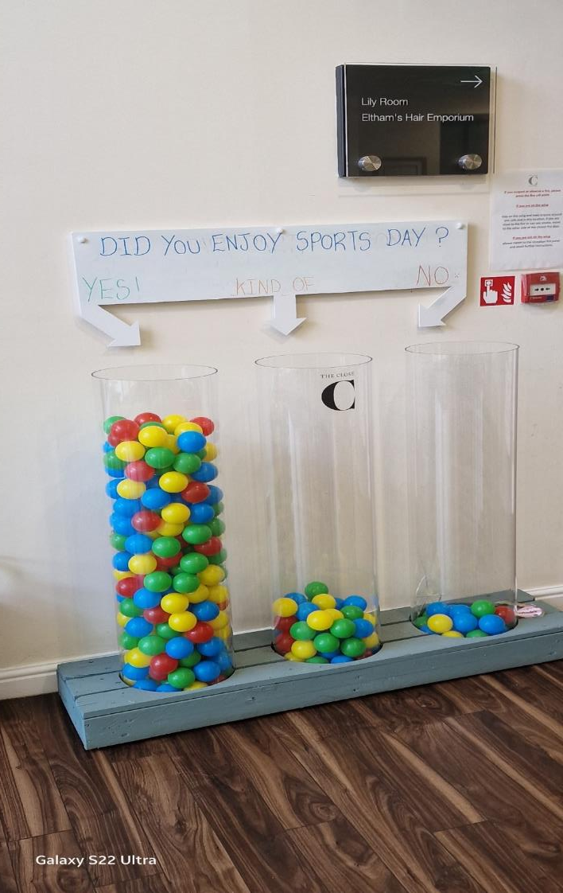
Voting Tubes

